Slide 1
The American Dream

Slide 2
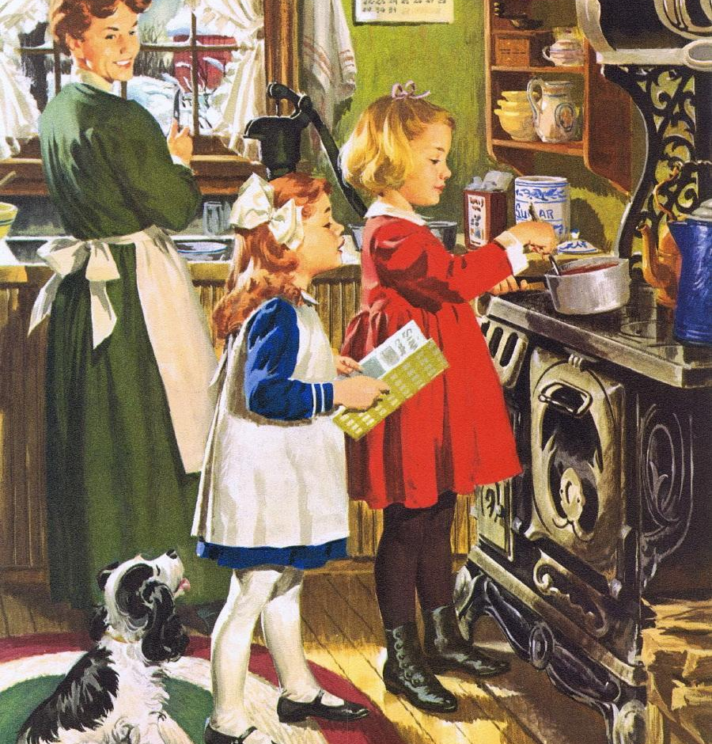
What Is the American Dream?

Slide 3

Is it still alive?

Slide 4
My Definition
My definition of the American dream would encapsulate many aspects covering topics such as economic mobility, stable economy, longevity, safety, housing as well as equal opportunity.
To provide thorough analysis on a few aspects I will be focusing on are Poverty, Equal Opportunity and Healthcare.

Slide 5
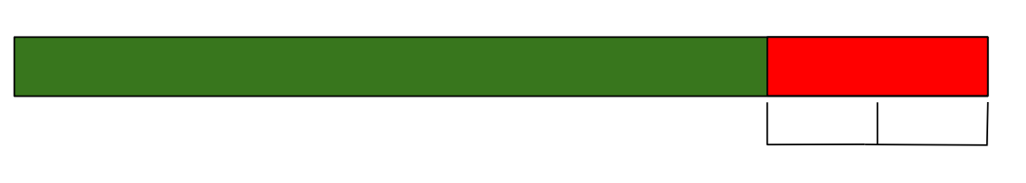
Wage Gap
~84%
Explained by observable characteristics
???
Labor market discrimination mainly from demand side.
Can still occur on supply side.
Uncertain exact amount of wage discrimination.

Slide 6
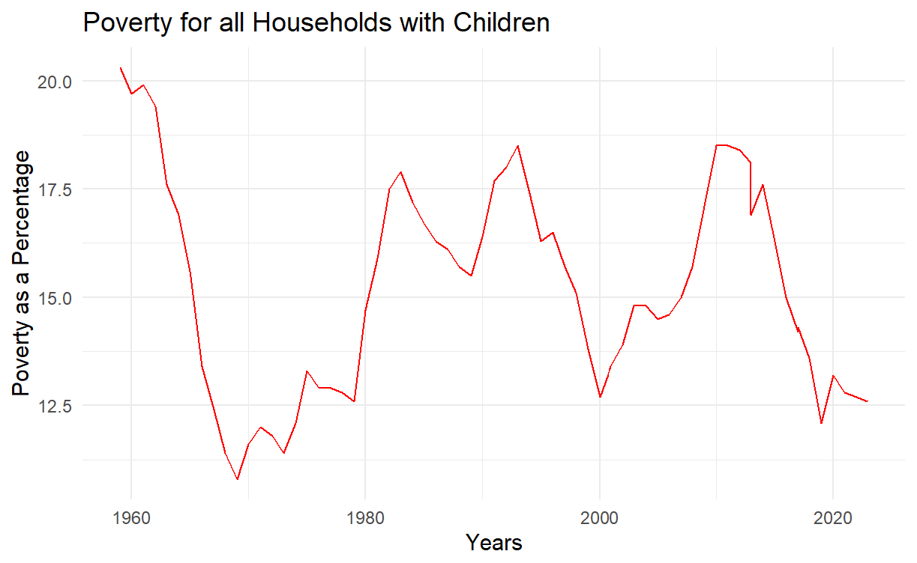
Poverty Implications
Large decrease in poverty rate among all families with children.
Married Households (with kids) have not seen changes in poverty rates.
Single Parent (Male) households have not seen changes in poverty rates.
Data: United States Census Bureau

Slide 7
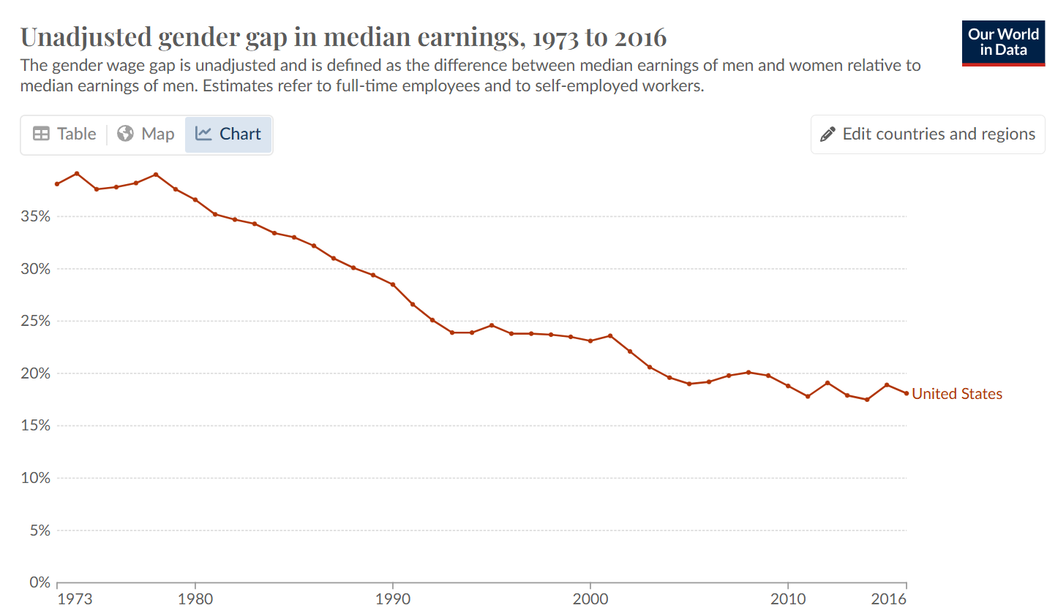
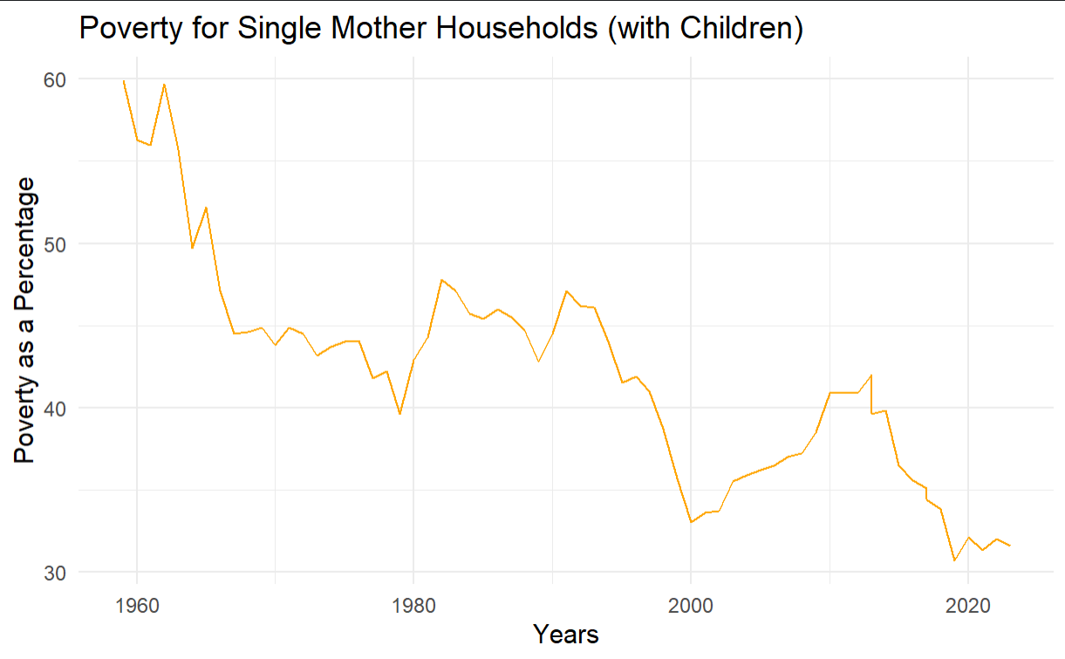
Poverty Implications
Source: Our World in Data
Data: United States Census Bureau

Slide 8

What Changed (Gary Becker)
Utility Matrix 1950
Larger wage gap.
Home tasks are more intricate and take more effort to complete.
More workplace discrimination.
Home Market
John
Alice
2
8
3
6

Slide 9
What Changed (Gary Becker)
Utility Matrix 2020
Advancement in technology (Y = AKªN^{1-a}).
More effort to integrate female workers into more high paying fields (i.e STEM).
Less need for complete specialization.
Female workers overall face a large substitution effect, encouraging them to substitute leisure for worktime.
Home Market
John
Alice
5
10
5
10

Slide 10

Healthcare
The “Iron Triangle” details the challenges to an efficacious healthcare system.
It is hard to balance out. For example, higher quality is harder to access.
Large proponent for why small countries with large GDP per capita are more likely to have some of the best healthcare systems.
Cost
Access
Quality

Slide 11
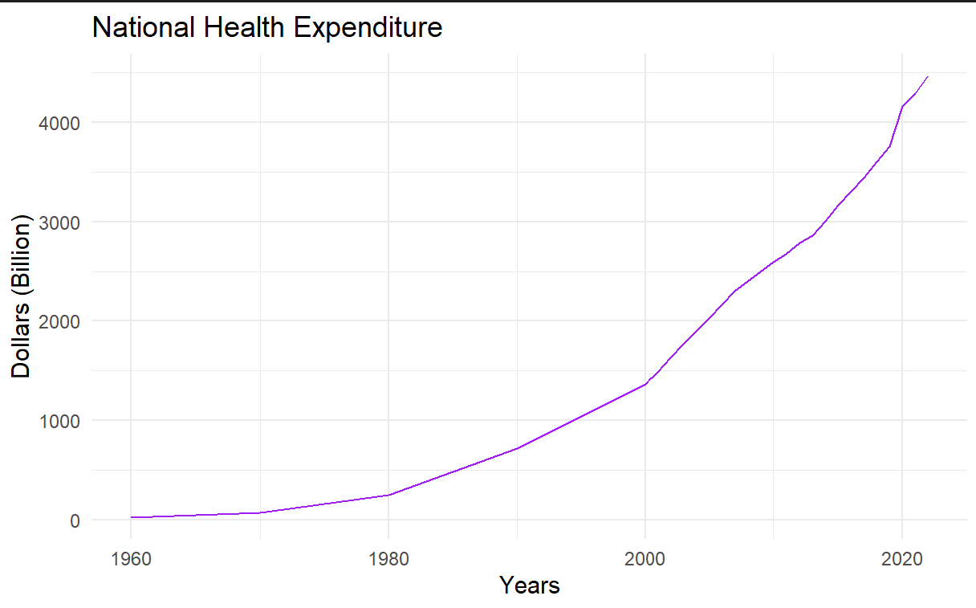
Healthcare Spending
Despite the United states spending more money per than any other country (per capita and overall), it is often criticized for being lacking.
“It is estimated that Americans spend $1 out of every $5.5 earned on healthcare.”
Dr. Miyoung Oh
Data: Centers for Medicare and Medicaid Services

Slide 12
Healthcare Challenges
Poor health outcomes
We are seeing the life expectancy decrease despite advancements in technology and information.
High spending
Many see healthcare as a profit-based system more aimed at generating revenue as opposed to providing care.
Unequal Access
Think like food deserts, rural or impoverished places are less likely to have immediate access to healthcare.

Slide 13

Addressing Access
A sick person with no disposable income is more likely to stay sick than somebody with coverage/disposable income.
Within this scenario, although the first person saves money by not seeing the doctor, he is more likely to miss work or develop more severe symptoms.
Although providing free high quality nationwide healthcare may not be possible for the foreseeable future, a good start would make sure everybody is covered.

Slide 14
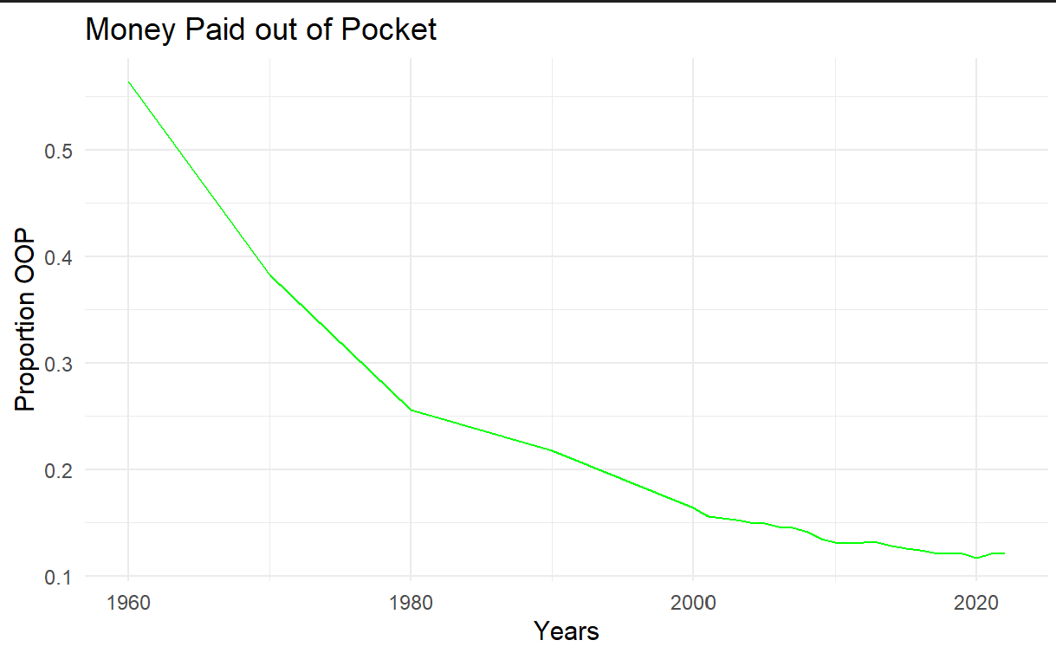
Addressing Access
Out of Pocket Spending
Out of Pocket Spending + Health Insurance Expenditures + Investment
All components of national health expenditures.
Data: Centers for Medicare and Medicaid Services

Slide 15
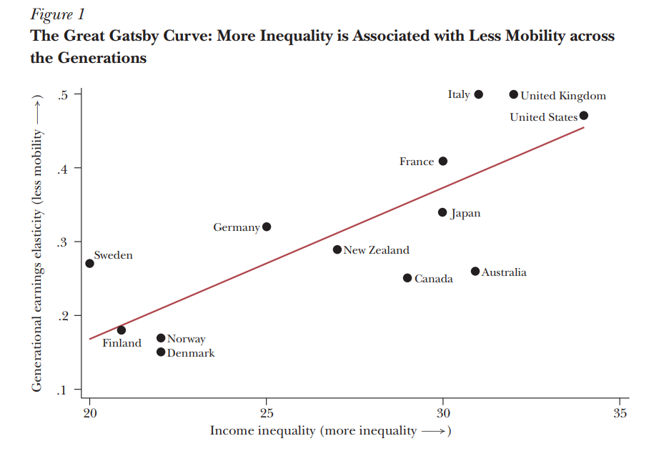
Intergenerational Mobility
The origin of the American dream is being able to make a name for yourself even if you start with nothing. America is known as the land of opportunity, but how much of this is true?
We observe a general trend that more income inequality correlates to less mobility.
Why do we observe this?
Source: Miles Corak

Slide 16
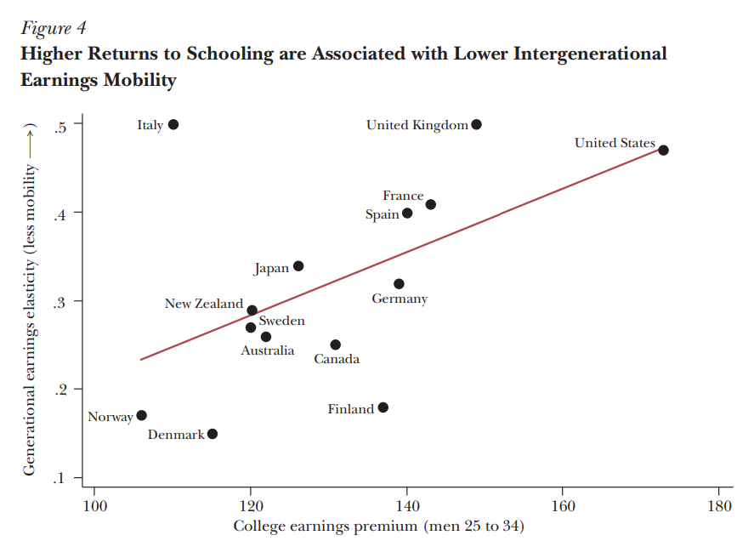
Intergenerational Mobility
Children born in higher quintiles will usually be “given” more capital to acquire skills.
Higher returns to education (like the US) often have less mobility. College graduates earn 70% more than high school graduates in the United States.
Source: Miles Corak

Slide 17
Conclusion
The traditional American dream is now obsolete.
Your path of life will likely look entirely different from one even thirty years ago that your parents may have had.
We do however need to take the good with the bad and realize what we have accomplished and what work there is left to do.
Perhaps we may even see the birth of the new American dream.

Slide 18

Thank You
Bureau, US Census. “Historical Poverty Tables: People and Families - 1959 to 2023.” Census.Gov, www.census.gov/data/tables/time-series/demo/income-poverty/historical-poverty-people.html.
Coontz, Stephanie. “Families and the American Dream.” Families and the American Dream | Iowa State University Library, 9 Feb. 1993, digitalcollections.lib.iastate.edu/islandora/object/isu%3ALectures_AV204132.
Corak, Miles. Income Inequality, Equality of Opportunity, and Intergenerational Mobility, stonecenter.gc.cuny.edu/files/2013/07/corak-income-inequality-equality-of-opportunity-and-intergenerational-mobility-2013.pdf.
“Mourning the American Dream by Susan Maxwell Schmidt.” Susan Maxwell Schmidt, susanmaxwellschmidt.pixels.com/featured/mourning-the-american-dream-susan-maxwell-schmidt.html.
“National Health Expenditure Data.” CMS.Gov, www.cms.gov/data-research/statistics-trends-and-reports/national-health-expenditure-data/historical#:~:text=U.S.%20health%20care%20spending%20grew,spending%20accounted%20for%2017.3%20percent.
“Norman Rockwell.” fOISinTheCity, ramblingsfromtheleft.wordpress.com/tag/norman-rockwell/.
Ortiz-Ospina, Esteban, et al. “Economic Inequality by Gender.” Our World in Data, 18 Mar. 2024, ourworldindata.org/economic-inequality-by-gender.
Repo Access

